Slide 1
Dr. Yifeng Zhu Electrical and Computer Engineering University of Maine
Embedded Systems with ARM Cortex-M3 Microcontrollers in Assembly Language and C
Chapter 9
64-bit Data Processing
Spring 2020

Slide 2
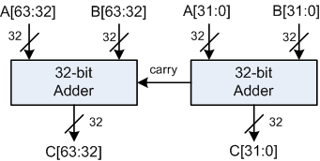
64-bit Addition
; Adding two 64-bit integers A (r1:r0) and B (r3:r2)
; C (r5:r4) = A (r1:r0) + B (r3:r2)
; A = 00002222FFFFFFFF, B = 0000044400000001
LDR r0, =0xFFFFFFFF ; A’s lower 32 bits
LDR r1, =0x00002222 ; A’s upper 32 bits
LDR r2, =0x00000001 ; B’s lower 32 bits
LDR r3, =0x00000444 ; B’s upper 32 bits
; Add A and B
ADDS r4, r2, r0 ; C[31:0] = A[31:0] + B[31:0], update Carry
ADC r5, r3, r1 ; C[64:32] = A[64:32] + B[64:32] + Carry

Slide 3
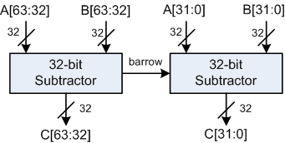
64-bit Subtraction
; Subtracting two 64-bit integers A (r1:r0) and B (r3:r2).
; C (r5:r4) = A (r1:r0) - B (r3:r2)
; A = 00000002FFFFFFFF, B = 0000000400000001
LDR r0, =0xFFFFFFFF ; A’s lower 32 bits
LDR r1, =0x00000002 ; A’s upper 32 bits
LDR r2, =0x00000001 ; B’s lower 32 bits
LDR r3, =0x00000004 ; B’s upper 32 bits
; Subtract A from B
SUBS r4, r0, r2 ; C[31:0] = A[31:0] - B[31:0], update Carry
SBC r5, r1, r3 ; C[64:32] = A[64:32] - B[64:32] + Carry - 1

Slide 4
64-bit Counting Leading Zeroes
; 64-bit input data = (r1:r0), r1 = upper word, r0 = lower word
; r2 = # of leading zero bits in the 64-bit data
; Counting # of leading zeroes in upper word
CLZ r2, r1 ; CLZ = Count leading zeroes
; Counting # of leading zeroes in lower word
CMP r2, #32
CLZEQ r3, r0 ; if r2 == 32, then count leading zero
; bits of the lower word
ADDEQ r2, r2, r3 ; if all bits of the upper word are zero,
; add the leading zeroes of the lower word

Slide 5
64-bit Sign Extension
; r0 = Lower word of 64-bit data
; r1 = Upper word of 64-bit data
TST r0, 0x80000000 ; Check the sign bit
LDREQ r1, =0xFFFFFFFF ; If MSB is 1, duplicate 1 in upper word
LDRNE r1, =0x00000000 ; If MSB is 0, duplicate 0 in upper word

Slide 6
64-bit Logic Shift Left

Slide 7
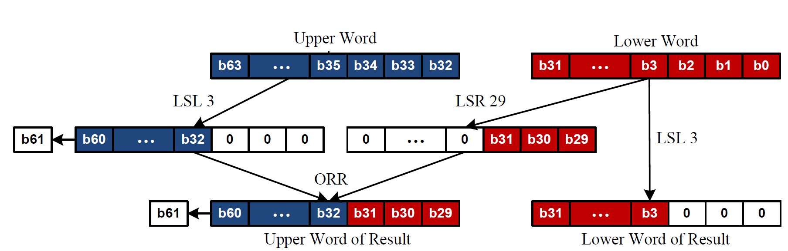
64-bit Logic Shift Left
Example of Logic Shift Left by 3

Slide 8
64-bit Logic Shift Right

Slide 9
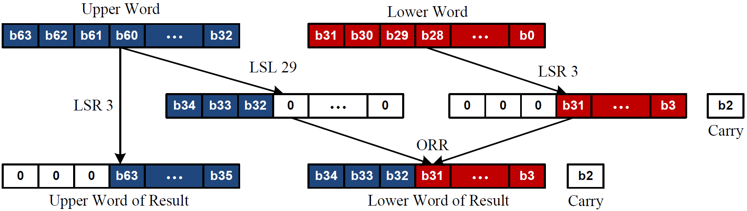
64-bit Logic Shift Right
Example of Logic Shift Right by 3

Slide 10
64-bit Multiplication
; product (r5:r4) = multiplier (r1:r0) × multiplicand (r3:r2)
; (r5:r4) = r0 × r2 + 2³² × (r1 × r2 + r0 × r3) + 2⁶⁴ × r1 × r3
; The last item exceeds 64 bits and thus it is ignored.
UMULL r4, r5, r0, r2 ; (r5:r4) = r0 * r2
MLA r5, r1, r2, r5 ; r5 = r5 + r1 * r2
MLA r5, r0, r3, r5 ; r5 = r5 + r0 * r3

